Slide 1
Financial Analytics: Market Cap & Sales Insights for Strategic Decision-Making
Done By: Nithinraaja

Slide 2
Task Objective
Analyze 459 companies to uncover patterns in market cap & quarterly sales, classify into categories, and give actionable recommendations.
Key Goals:
Identify top companies by market cap & sales
Categorize into Large, Mid, Small, Very Small tiers
Visualize trends for stakeholders
Summarize in a quick-reference storyboard

Slide 3
Dataset Used: Financial-Analytics-data1.xlsx
Company Name
Market Cap (₹ crore)
Quarterly Sales (₹ crore)
Market Cap Category
Sales Category

Slide 4
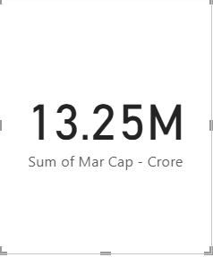
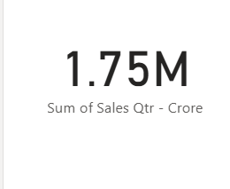
Financial Analytics – Summary
Dataset Size: 459 companies
Total Market Cap: ₹13,25,177 crore
Total Quarterly Sales: ₹17,47,775 crore

Slide 5
Top 5 by Market Cap
Reliance Industries – ₹5,83,437 Cr
TCS – ₹5,63,710 Cr
HDFC Bank – ₹4,82,954 Cr
ITC – ₹3,20,985 Cr
HDFC – ₹2,89,497 Cr

Slide 6
Top 5 by Quarterly Sales
IOCL – ₹1,10,667 Cr
Reliance Industries – ₹99,810 Cr
Tata Motors – ₹74,156 Cr
BPCL – ₹60,616 Cr
HPCL – ₹57,474 Cr

Slide 7
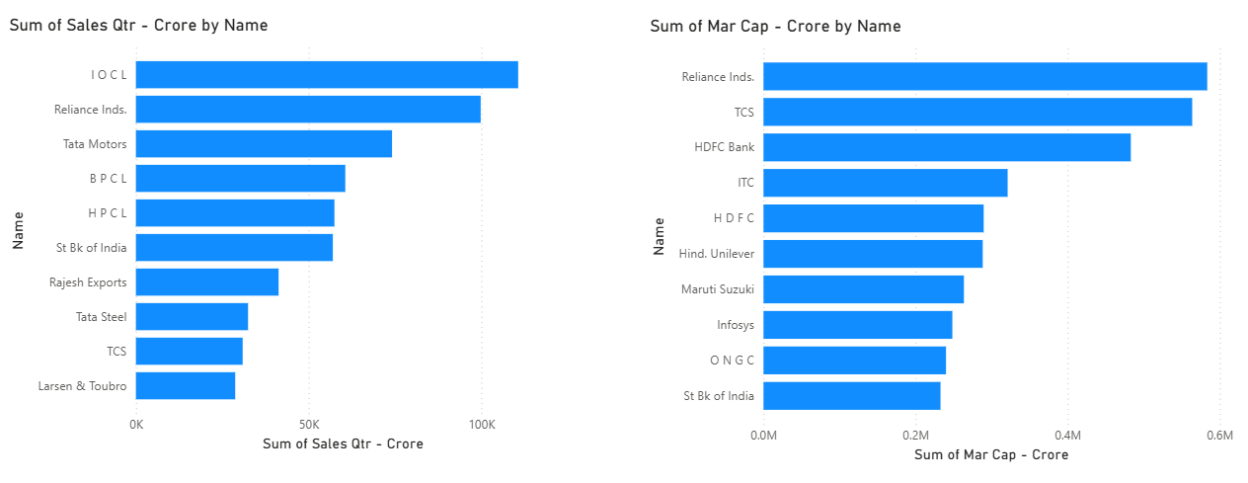

Slide 8
Market Cap Category Distribution
Large Cap: 119 companies
Mid Cap: 116 companies
Small Cap: 115 companies
Very Small Cap: 109 companies

Slide 9
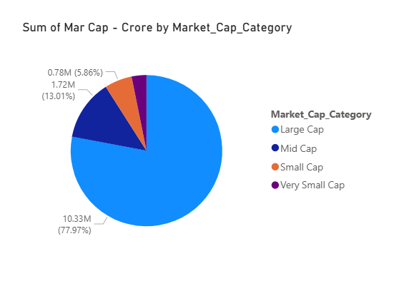

Slide 10
Sales Category Distribution
High Sales: 115 companies
Medium Sales: 115 companies
Low Sales: 114 companies
Very Low Sales: 115 companies

Slide 11
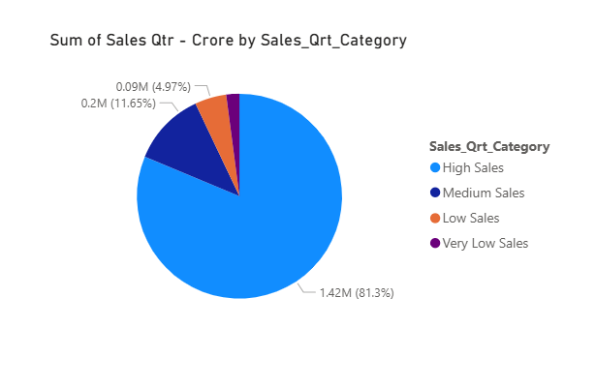

Slide 12


